Slide 1

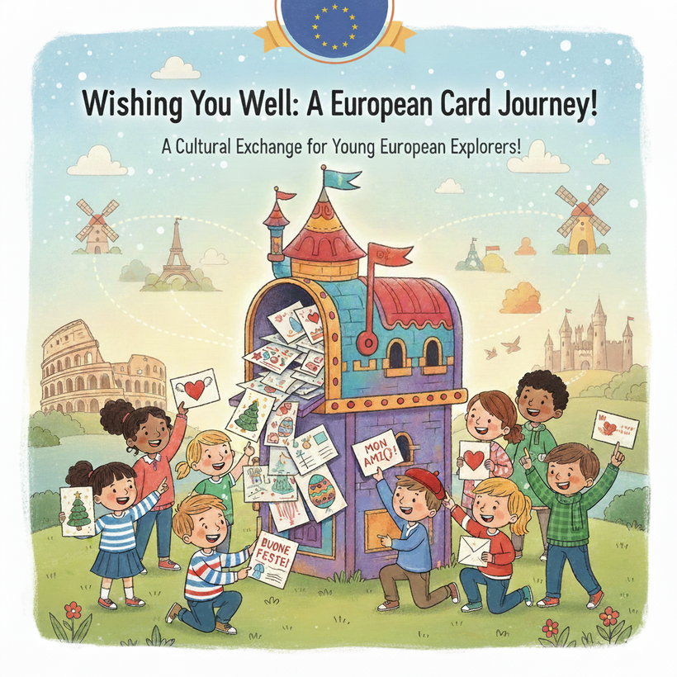
Wishing You Well: A European Card Journey

Slide 2
Age Group
9 years old (Primary School – Fourth Grade)
Project Duration
6 months (December-May)
Partner Countries
Italy -
Language
English (basic level, supported by visual materials and native language translations)

Slide 3
Overview
"Wishing You Well: a European Card Journey" is an eTwinning project designed to promote cultural awareness and communication skills among young European students through the exchange of festive postcards. The project uses simple English, supported by visuals, to connect Italian students (L2 learners) with peers across Europe during significant holidays.

Slide 4
Aims
  Strengthen Communication Skills: Practice basic English through short, written messages on postcards.
  Foster Intercultural Understanding: Introduce students to different European customs and traditions, focusing on holiday celebrations.
  Encourage Creativity: Develop artistic skills through the creation and decoration of postcards.
  Promote Digital Literacy: Utilize online tools (TwinSpace) for sharing photos, tracking exchanges, and comparing work.
  Build a Sense of European Community: Connect students across borders through shared activities and mutual respect.

Slide 5
Key Competences
  Multilingual: Use English in a simple, practical, and meaningful context.
  Cultural awareness and expression: Learn about and express different cultural celebrations.
  Digital: Use online platforms for sharing and collaboration.
  Personal, social and learning to learn: Practice collaboration, patience, and excitement for receiving mail.

Slide 6
Activities
December
1. Getting to Know Each Other
  Our Class Introduction: Each partner class creates a short video/slideshow introducing themselves, their school, and their town/country. They create a simple self-portrait "ID card" with their name, age, and one favorite thing.
2. Christmas Postcard Exchange
  Students design and write simple Christmas or Winter Holiday postcards to their partner class(es). Focus: Simple greetings ("Happy Holidays!", "Merry Christmas!"), drawing holiday symbols/traditions from their culture.

Slide 7
Activities
February
  Friendship Heart Exchange:
  Students create heart-themed postcards or "Kindness Cards" for Valentine's Day. Focus: Messages about friendship, kindness, and partnership ("You are kind!", "Be my friend!").

Slide 8
Activities
April
4. Easter Postcard Exchange:
  Students draw and write about a common Easter or Spring celebration symbol from their region (e.g., eggs, flowers, specific foods). Focus: Simple descriptions and wishes ("Hello Spring!", "Happy Easter!").
.

Slide 9
Activities
May
5. Celebrating Europe Day:
  Students learn about Europe Day and what it means (peace and unity). They create a collaborative digital poster or postcard representing what Europe means to them (e.g., drawing flags, monuments, or friendly figures). Focus: Unity, Cooperation, European identity.

Slide 10
Tools and Platforms
  eTwinning TwinSpace
  Canva for collaborative design
  Padlet for sharing ideas and photos
  Google Slides or PowerPoint for presentations
  Video tools for introductions

Slide 11
Expected Outcomes
  A deeper understanding of different European cultures and holiday traditions.
  Increased motivation for learning and using basic English in a real-world context.
  A collection of festive, hand-made postcards from European friends.
  Enhanced skills in art, communication, and digital collaboration.

Slide 12
Dissemination
  Display project outcomes on school websites and local events.
  Share the final digital book with families and the school community.
  Present the project during eTwinning Day or Europe Day celebrations.

