Slide 1

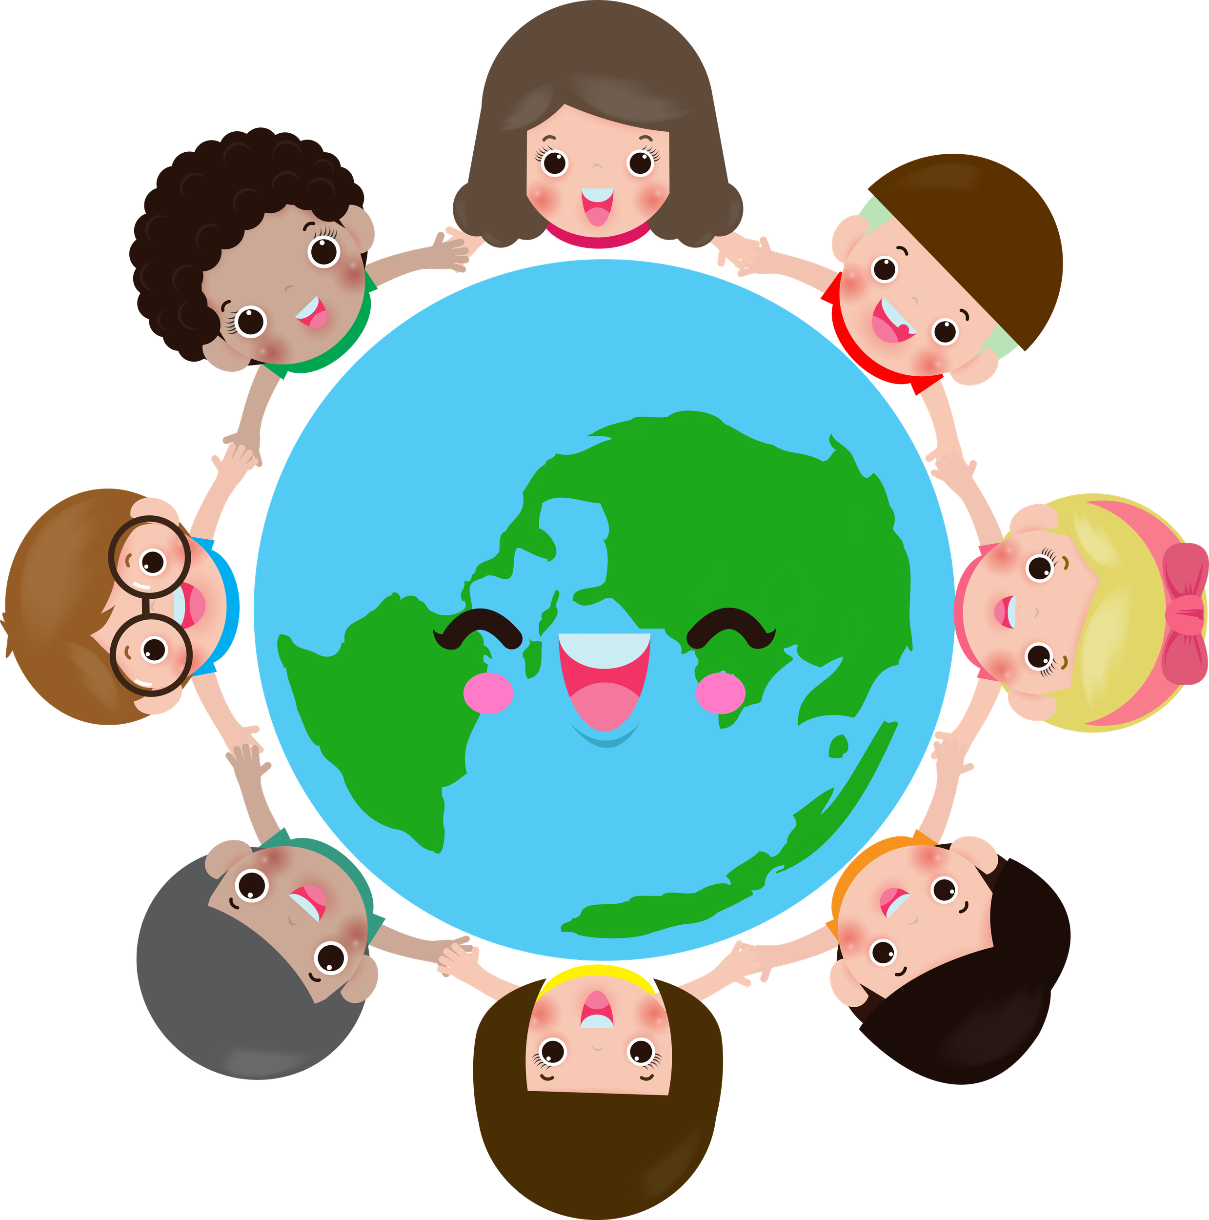
Little Citizens of the world

Slide 2
Age Group
6-8 years old (Primary School – First and Second Grade)
Project Duration
6 months (December-May)
Partner Countries
Italy, Turkey
Language
English (basic level, supported by visual materials and native language translations)

Slide 3
Overview
"Little Citizens of the World" is an eTwinning project designed to introduce young learners to the concept of citizenship through playful, creative, and collaborative activities. The project encourages children to explore values such as respect, kindness, cooperation, and responsibility while discovering cultural diversity across Europe.

Slide 4
Aims
  Develop an early understanding of citizenship and community.
  Promote respect for diversity and inclusion.
  Encourage teamwork and empathy through shared activities.
  Foster digital literacy and safe online collaboration.
  Strengthen communication skills through art, storytelling, and simple English.

Slide 5
Key Competences
  Citizenship
  Cultural awareness and expression
  Multilingual
  Digital
  Personal, social and learning to learn

Slide 6
Activities
December
1. Getting to Know Each Other
  Who am I? Create an ID card for each student
  Exchange short video introductions of each class.
  Create a collaborative map showing where each school is located.
  Draw national flags and share them on the TwinSpace.
2. Our Classroom Rules
  Discuss what makes a good citizen in the classroom.
  Create a “Class Citizenship Charter” with drawings and simple sentences.
  Share and compare charters among partner schools.

Slide 7
Activities
January
3. Kindness Tree
  Each child draws or writes one kind action they can do.
  Collect all leaves to create a digital “Kindness Tree” shared by all schools.
4. Cultural Exchange
  Share photos or short videos of local traditions, songs, or celebrations.
  Create a digital “Book of Traditions” using Canva or similar tools.

Slide 8
Activities
February
5. Our Rights and Responsibilities
  Introduce basic children’s rights through stories and illustrations.
  Children take turns drawing, on a common canvas (digital with tools like Jamboard, if accessible), an element of their city or neighborhood they deem important (a park, a street sign, a monument).
  Create posters showing rights and responsibilities at school and home
.

Slide 9
Activities
March
6. Eco-Citizens
  Organize a simple recycling or planting activity.
  Share photos and reflections on how to take care of the planet.
April/May
7. Final Product
  Create a collaborative digital book titled “Little Citizens of the World” including drawings, photos, and short texts from all partner schools.
  Create “The Memory Bag” in which every child chooses his/her favourite moment of the project and draws it. This can be shared with families.

Slide 10
Tools and Platforms
  eTwinning TwinSpace
  Canva for collaborative design
  Padlet for sharing ideas and photos
  Google Slides or PowerPoint for presentations
  Video tools for introductions

Slide 11
Expected Outcomes
  Increased awareness of citizenship and community values.
  Improved social and communication skills.
  Enhanced creativity and digital collaboration.
  Strengthened European identity and intercultural understanding.

Slide 12
Dissemination
  Display project outcomes on school websites and local events.
  Share the final digital book with families and the school community.
  Present the project during eTwinning Day or Europe Day celebrations.

